Slide 1
Appendix B
The Altera Nios II Processor

Slide 2
Appendix Outline
Processor characteristics
General-purpose registers
Assembly-language instructions
Pseudoinstructions and assembler directives
Example programs
Control registers for interrupts and exceptions
Input/output capabilities

Slide 3
Nios II Characteristics
Implemented using Altera CAD software tools in field-programmable gate-array (FPGA) chips
RISC-style architecture, 32-bit word length
Byte-addressable, 32-bit address space
Little-endian addressing scheme
Word, half-word, and byte data transfers
32 general-purpose registers, each 32 bits
Several additional control registers

Slide 4
Use of General-Purpose Registers
r0 always contains the constant 0
r1 (at) is assembler temporary register
r24 (et), r29 (ea) are for exception processing
r25 (bt), r30 (ba) are reserved exclusively for the JTAG Debug Module, used in debugging
r26 (gp) is global pointer to user prog. data
r27 (sp) is processor stack pointer
r28 (fp) is frame pointer
r31 (ra) is link register for return address

Slide 5
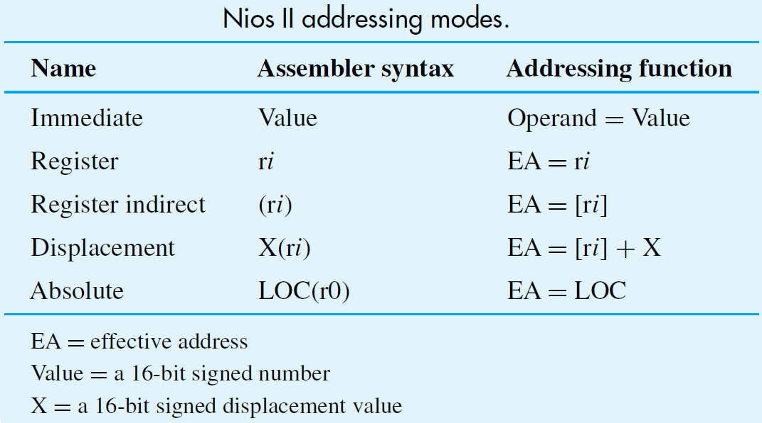
Addressing Modes

Slide 6
Instructions
RISC-style instructions as in Chapter 2
Load/store architecture for data transfers
Arithmetic/logic instructions use registers
Three instruction formats:
OP dst_reg, src_reg1, src_reg1
OP dst_reg, src_reg, immediate
call label_or_address
Immediates do not use ‘#’ or other characters

Slide 7
Notation
Nios II assembler from Altera is case-sensitive for register identifiers (must be lower-case)
Altera uses lower-case instruction mnemonics
in its technical documentation
Hence, lower-case used in this presentation
Remainder of presentation is a summary;
details are available at http://www.altera.com
in the Nios II Processor Reference Handbook

Slide 8
Load and Store Instructions
For moving data between memory (or I/O)
and general-purpose registers
Words, half-words, bytes; alignment required
Variants available for I/O (uncached) access
Examples:
ldw r2, 40(r3) (load word)
stb r6, 4(r12) (store byte) ldhio r9, (r20) (load I/O halfword)

Slide 9
Arithmetic Instructions
add, addi (16-bit immediate is sign-extended)
sub, subi, mul, and muli are similar
Mult. is unsigned, result is truncated to 32 bits
div (signed values), divu (unsigned values)
Examples:
add r2, r3, r4 (r2 ← [r3] + [r4])
muli r6, r7, 4096 (r6 ← [r7] × 4096)
divu r8, r9, r10 (r8 ← [r9] / [r10])

Slide 10
Logic Instructions
and, or, xor, nor have register operands
andi, ori, xori, nori have immediate operand
that is zero-extended from 16 bits to 32 bits
Examples:
or r7, r8, r9 (r7 ← [r8] OR [r9])
andi r4, r5, 0xFF (r4 ← [r5] AND 255)
andhi, orhi, xorhi shift immediate 16 bits left and clear lower 16 bits of immediate to zero

Slide 11
Move Instructions
Pseudoinstructions provided for convenience: mov ri, rj ⇒ add ri, r0, rj movi ri, Val16 ⇒ addi ri, r0, Val16 moviu ri, Val16 ⇒ ori ri, r0, Val16
Move Immediate Address for 32-bit value:
movia ri, LABEL ⇒ orhi ri, r0, LABEL_HI
or ri, ri, LABEL_LO
LABEL_HI is upper 16 bits of LABEL, and
LABEL_LO is lower 16 bits of LABEL

Slide 12
Branch and Jump Instructions
Unconditional branch: br LABEL
Instruction encoding uses signed 16-bit offset
Signed/unsigned comparison and branch:
blt ri, rj, LABEL (signed [ri] < [rj])
bltu ri, rj, LABEL (unsigned [ri] < [rj])
beq, bne, bge, bgeu, bgt, bgtu, ble, and bleu
Unconditional branch beyond 16-bit offset:
jmp ri (jump to address in ri)

Slide 13
Subroutine Linkage Instructions
Subroutine call instruction: call LABEL
Saves return address (from PC) in r31 (ra)
Target encoded as 26-bit immediate, Value26
At execution time, 32-bit address derived as:
Jump address = PC₃₁₋₂₈ : Value26 : 00
Call with target in register: callr ri
Return instruction: ret
Branches to address saved in r31 (ra)

Slide 14
Parameter Passing & Stack Frames
Pass parameters in register or using stack
Build stack frames for private work space and
saving registers when nesting subroutine calls
Called routine always saves frame ptr r28 (fp) before creating its own private work space
Return addr r31 (ra) saved to enable nesting
Use fp with displacement to access stack data:
ldw r4, 8(fp)

Slide 15
Comparison Instructions
Result of comparing two operands is placed in destination register: 1 (if true) or 0 (if false)
Less-than comparisons that set ri to 0 or 1:
cmplt ri, rj, rk (signed [rj] < [rk])
cmpltu ri, rj, rk (unsigned [rj] < [rk])
cmplti ri, rj, Val16 (signed [rj] < Val16)
cmpltui ri, rj, Val16 (unsigned [rj] < Val16)
Val16 is sign- or zero-extended based on type
Similarly for: ...eq.., ...ne.., …le.., …ge.., ...gt..

Slide 16
Shift and Rotate Instructions
Shift right logical rj, destination register is ri:
srl ri, rj, rk (shift amount in rk)
srli ri, rj, Val5 (immediate shift amount)
Shift right arithmetic sra, srai: same as above
except that sign in bit rj₃₁ is preserved
Shift left logical sll, slli
Rotate left rol, roli
Rotate right ror (no immediate version)

Slide 17
Control Instructions
Special instructions to access control registers
Read Control Register instruction:
rdctl ri, ctlj (ri ← [ctlj])
Write Control Register instruction:
wrctl ctlj, ri (ctlj ← [ri])
Instructions trap, eret deal with exceptions
(similar to call, ret but for different purpose)
Additional instructions for cache management

Slide 18
Pseudoinstructions
mov, movi, and movia already discussed;
translated to other instructions by assembler
Subtract immediate is actually add immediate with negation of constant:
subi ri, rj, Value16 ⇒ addi ri, rj, −Value16
Also can swap operands for comparisons:
bgt ri, rj, LABEL ⇒ blt rj, ri, LABEL
Awareness of pseudoinstructions is not critical except when examining assembled code

Slide 19
Assembler Directives
Nios II assembler directives conform to
those defined by widely used GNU assembler:
.org Value (code/data origin)
.equ LABEL, Value (equate to label)
.byte expressions (define byte data)
.hword expressions (define halfwords)
.word expressions (define word data)
.skip Size (reserve bytes)
.end (end of source code)

Slide 20
Carry/Overflow Detection for Add
Nios II does not have condition codes
Arithmetic performed in same manner
for signed and unsigned operands
Detect carry/overflow with more instructions
Carry: test if unsigned result < either operand:
add r4, r2, r3
cmpltu r5, r4, r2
Carry bit is in r5

Slide 21
Carry/Overflow Detection for Add
Overflow: compare signs of operands & result
Use xor, and to check for same operand signs and different sign for result:
add r4, r2, r3
xor r5, r4, r2
xor r6, r4, r3
and r5, r5, r6
blt r5, r0, OVERFLOW
Similar checks for subtract carry/overflow

Slide 22
Example Programs
Vector dot product performs multiplication and addition operations for array elements
String search uses nested loops to
match given pattern in target string

Slide 23
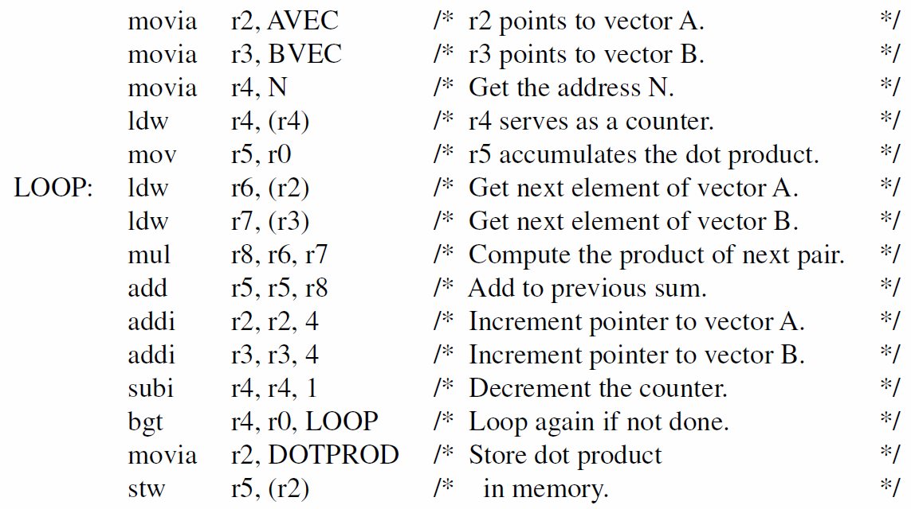

Slide 24
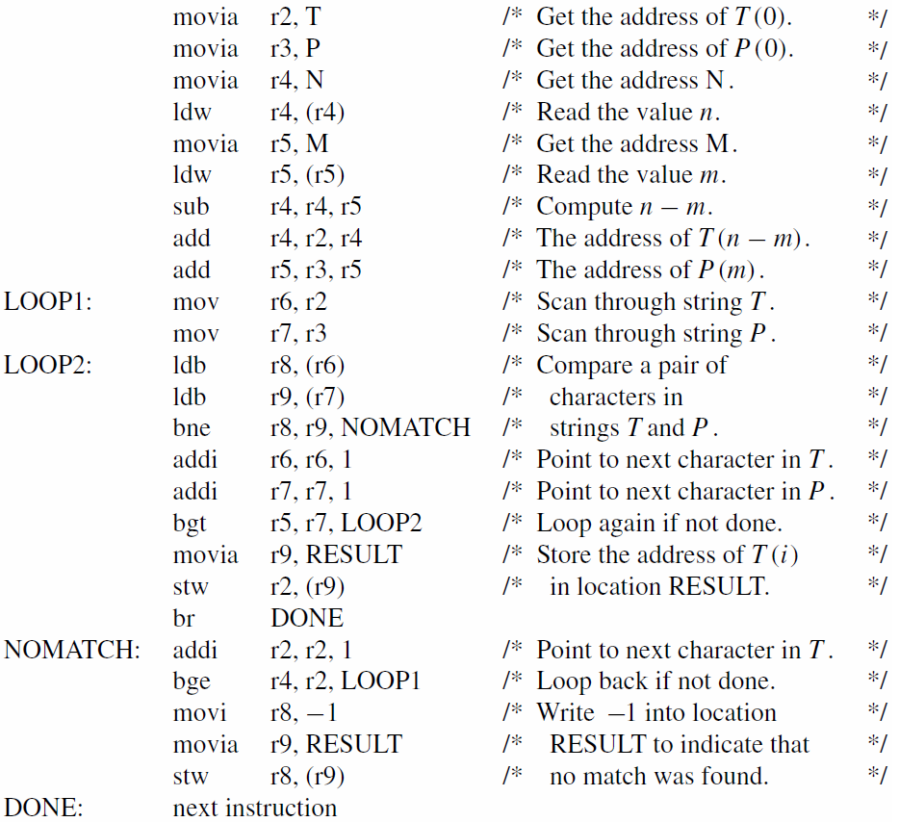

Slide 25
Control Registers
ctl0 (status) and ctl1 (estatus) are the
current and exception-saved status registers
U & EU bits for user/supervisor mode
PIE & EPIE bits for processor interrupt enable
ctl2 (bstatus) saves status for debug breaks
ctl3 (ienable) for individual interrupt sources
ctl4 (ipending) identifies pending sources
ctl5 (cpuid) used in multiprocessor systems

Slide 26
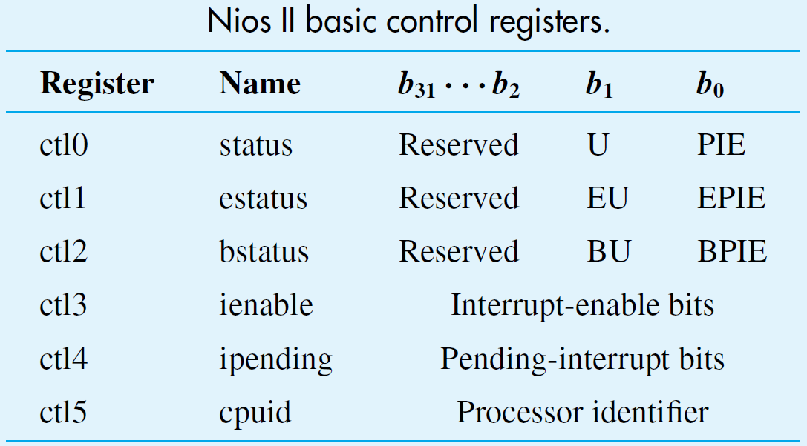

Slide 27
Input/Output
Use I/O versions of Load/Store instructions
Polling for program-controlled output:
movia r6, DATA_REG_ADDR
mov r7, DATA_TO_SEND
movia r4, STATUS_REG_ADDR
L1: ldbio r5, (r4)
andi r5, r5, STATUS_FLAG_BIT
beq r5, r0, L1
stbio r7, (r6)

Slide 28
Interrupts and Exceptions
Hardware interrupts from I/O sources
Exceptions include trap or invalid instruction
Processor saves status contents in estatus, clears U bit and PIE bit in status, and
writes return address (from PC) in r29 (ea)
Transfers execution to exception handler
eret instruction returns from handler using ea
Depending on case, ea adjustment needed

Slide 29
Advanced Nios II Configurations
Nios II implementation in FPGA chip provides flexibility to create enhanced configurations
Additional modules included at design time
Hardware-based interrupt priority resolution provided by external interrupt controller
Memory management unit offers support for sophisticated operating system software
Floating-point hardware & more instructions

Slide 30
Concluding Remarks
Nios II is a flexible 32-bit RISC-style processor for implementation in FPGA chips
Configurability at design time to suit needs
32 registers & an extensive instruction set
I/O versions of Load/Store instructions
Control registers & other special instructions
FPGA technology makes Nios II affordable & easy to use – excellent for educating students

